Slide 1


Cordova Elementary Optional School
Dr. Tonya J. Miller, Principal
Annual Title I Meeting
August 28, 2024, 11:30 a.m.
August 28, 2024, 5:30 p.m.
Dr. Tonya J. Miller, Principal
Mrs. Sheena Robinson, Assistant Principal
Dr. Keisha Gunter, Assistant Principal
Dr. Michelle Elmore Lake, PLC Coach

Slide 2

DTE Title I Status
The Every Student Succeeds Act (ESSA) requires that each Title I school hold an annual meeting to:
Inform you of your school’s participation in Title I
Explain the requirements of Title I
Explain your rights as parents & family members to be involved.

Slide 3

Principles Behind ESSA
Closing the achievement gap
Increasing accountability by rewarding success and sanctioning failure
Improving literacy by putting reading first
Improving teacher quality
Promoting more choices for parents and making more information available for parents
(Parents Right to Know)
Making schools safer for the 21st Century

Slide 4
Every Student Succeeds Act
PURPOSE:
“To ensure that all children have a fair, equal, and significant opportunity to obtain a high-quality education.”

Slide 5
DTE Title I Status
Cordova Elementary Optional School IS a Title I School that receives federal funds to supplement educational activities to enhance academic achievement.
Cordova Elementary Optional School is a Level 1 school based on TNReady scores, attendance, and overall, TVAAS level.

Slide 6
Every Student Succeeds Act of 2015
Title I
Improve Academic Achievement for Disadvantaged Students
Criteria: 74% of student population receives free or reduced lunch
Title I Schoolwide Programs
Provide resources to improve achievement as specified in School Improvement Plans (Updated technology: SmartBoards, Computers, etc.)

Slide 7
Components of a Title I Schoolwide Program
Needs assessment
Schoolwide reform strategies that:
  Increase the amount & quality of learning time
  Address needs of all, but particularly low-achieving students
Instruction by highly qualified teachers
Professional development for staff
Strategies to attract high quality teachers
Parental involvement
Transition from pre-school and from elementary to middle
Include teachers in assessment decisions
Coordination and integration of Federal, State and local programs

Slide 8



Parent Communication/
Reporting Student Progress
Daily communication in CUB Communicator folder
Progress reports (1st one issued: September 4th)
Monthly school calendar
Messages on DoJo App
Updates on the school website
Phone calls/notes
FaceBook @CordovaOptionalElem
Parent-Teacher Conferences
  District Wide: September 5, 2024, from 4:00 pm – 7:00 pm
  District Wide: February 13, 2025, from 4:00 pm – 7:00 pm
  Please sign up for a time with homeroom teacher

Slide 9
Family Engagement /Parental Involvement
District Policy/School Policy (Policy # 6156 provided)
Parent Training Meetings
Attend Parent-Teacher Conferences (Sept. 5th)
School-Parent Compacts (Review with student, sign & return)
Family Engagement Plan (You will keep this form)

Slide 10
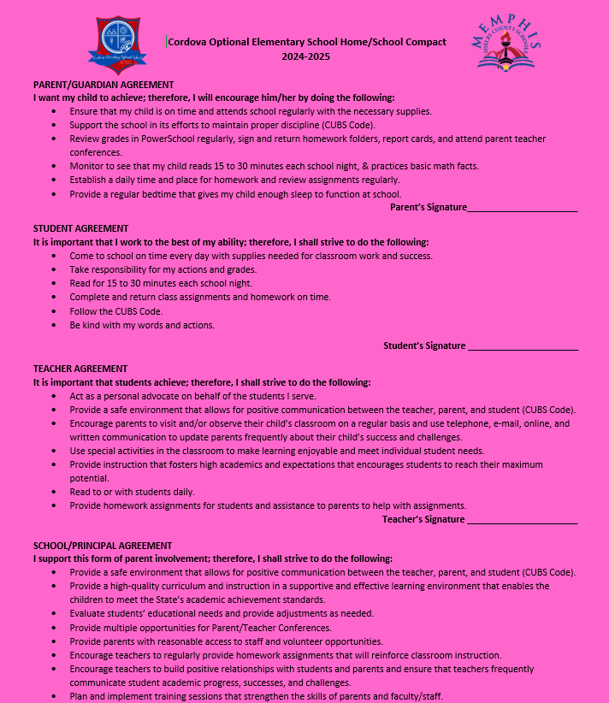
Family Engagement /Parental Involvement
School-Parent
Compacts
Review with student,
sign & return

Slide 11
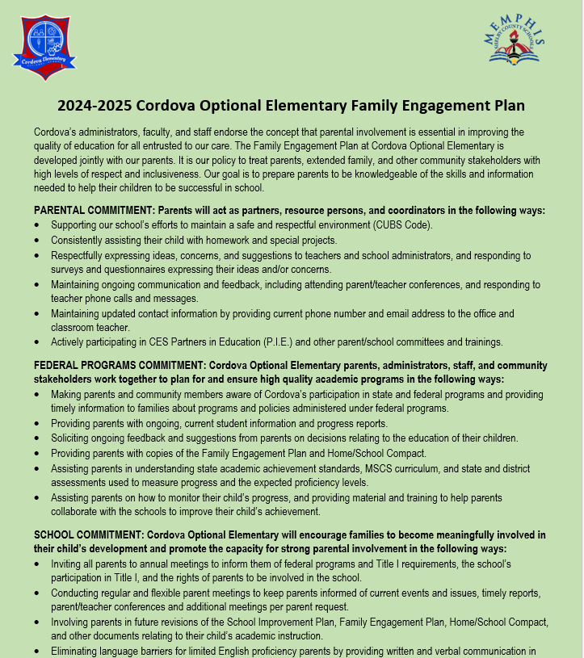
Family Engagement /Parental Involvement
Family Engagement
Plan
You will keep this form

Slide 12
Parents Right to Know
Notify parents:
Of right to request data on qualification of teachers
If child is taught by a teacher not highly qualified (May request qualifications of teachers)
If child is provided instruction by a paraprofessional
If a teacher is hired for more than 4 weeks and is not highly qualified
If a school is identified unsafe
Right to transfer if child is a victim of a violent crime
Request child’s info is not released to military recruiter without prior consent
Eligibility for Service if Homeless/Displaced (Title X Part C- McKinney-Vento Act)

Slide 13
Suggested WAYS PARENTS CAN BE INVOLVED
Encourage attendance
Monitoring grades in PowerSchool
Review student schoolwork on a regular basis
Ask your CUB “What did you learn today?”
Attend parent trainings and school events
Participate in school fundraisers
Become a member of PIE (Partners In Education)
Testing Proctors, & more!

Slide 14
What are our Schoolwide Program Focus and Goals for this Year in the School Improvement Plan?
Early Literacy (K-2)
Wonders Reading and Writing
Reading/Language Arts (K-5)
Wonders Reading and Writing
Mathematics (K-5)
Envision
Chronic Absenteeism
Leading with Consistency, Connection, & Compassion!!!

Slide 15
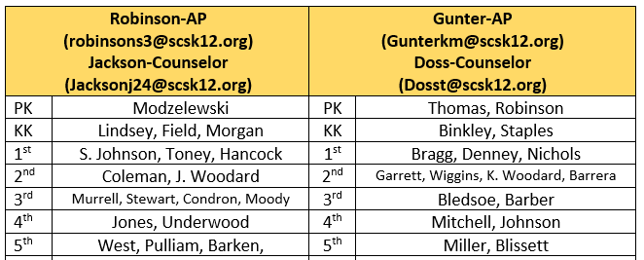
Who Do I Contact For Assistance?
Main Office: 901-416-1700
Submitting feedback about our SIP, Family Engagement, or School Compact
Email Dr. Michelle Elmore Lake, PLC Coach, elmoremr@scsk12.org
Leading with Consistency, Connection, & Compassion!!!

Slide 16
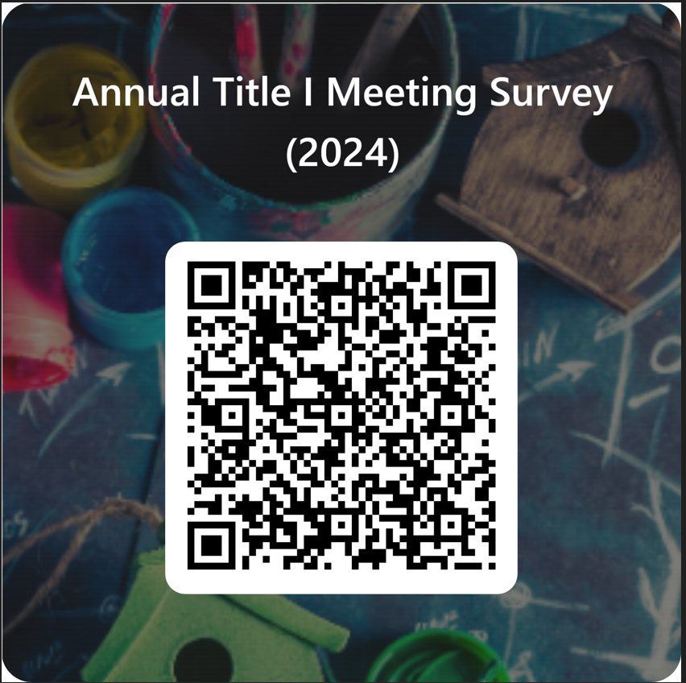
Thanks for Coming!
Your feedback is vital to our success
Please scan QR Code and Complete Survey
Leading with Consistency, Connection, & Compassion!!!

